Slide 1

SEC 504 Course Roadmap
Incident Handling
Applied Incident Handling
Attack Trends
Step 1: Reconnaissance
Step 2: Scanning
Step 3: Exploitation
Gaining Access
Web App Attacks
Denial of Service
Step 4: Keeping Access
Step 5: Covering Tracks
Conclusions
App-level Trojan Horse Backdoor Suites
Setiri
Wrappers and Packers
Memory Analysis
User-Mode Rootkits
LRK
AFX Windows Rootkit
Kernel-Mode Rootkits
KBeast
Kernel Intrusion System
Solaris
FU and FUTo Rootkits
Lab: Shim Rootkits
Notes:
Now, lets get our hands dirty with shim rootkits!

Slide 2
Lab: Playing with Shims
Windows Application Compatibility Toolkit
Allows older applications to run on newer versions of Windows
Older applications may expect registry keys, directories and applications to be in different locations
The Application Compatibility Toolkit allows Windows to “lie” to these applications by “shimming” them
All based on a .sdb file which defines which application is to be shimmed and how it is to be shimmed
Over 800 different shimming options
Using the ‘sdbinst [shim.sdb]’ command allows us to insert these shims
‘sdbinst –u [shim.sdb]’ uninstalls these shims
Shims were created by Mark Baggett
Notes:
Many people do not know that Windows has built-in Shim technology which looks and acts a lot like a standard user-mode rootkit. It allows a user to inject execution redirection and modification of output back to a user. And yes, it is built into Windows.
But why? Because of reverse compatibility. When creating applications for different versions of Windows there is a need to present a different view of the Windows operating system to an application which is running on Windows 7 vrs. Windows XP. To address this issue, Microsoft created the Application Compatibility Toolkit (ACT). ACT allows a developer to redirect and manipulate how the operating system file system, registry and processes are presented to various applications. All you need to do is “shim” the application with a .sdb file. But what if a malicious user were to “shim” processes like Explorer.exe, or cmd.exe? That would be a rootkit!
In this section we will be playing with a handful of .sdb files created by Mark Baggett. These files are very basic shims which will demonstrate the capabilities of rootiks.

Slide 3
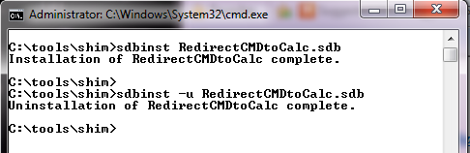
Getting Started
First, extract the files from the sampleShims.zip file from the Windows directory on your course DVD to the C:\Tools directory on your Windows system
You should have 5 different .sdb files
To install a shim simply run sdbinst and a .sdb file
C:\> sdbinst [.sdbfile]
To remove a shim simply run sdbinst and a .sdb file with the –u switch
C:\> sdbinst –u [.sdbfile]
Notes:
We will first need to extract the sampleShims.zip file to your C:\tools\shim folder. This file has a number of cool shims for us to play with. We will be playing with three different shims, but please feel free to play with the others when you have time.
To install a shim simply run the sdbinst comand:
C:\> sdbinst [.sdbfile]
To remove a shim, simply run the above command with the –u option which stands for “uninstall”.
C:\> sdbinst –u [.sdbfile]

Slide 4
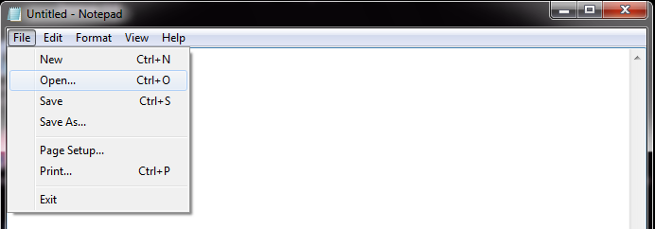
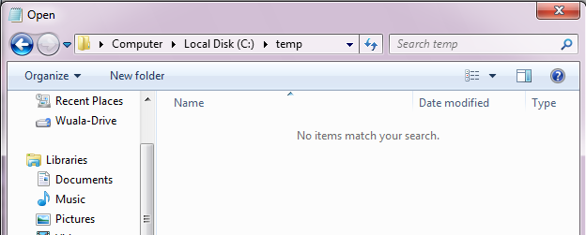
Shimming Notepad
If you do not have a C:\TEMP directory please create it
C:\> mkdir C:\temp
Now, open notepad and navigate to the C:\TEMP directory
Take note of the contents (or lack thereof)
0
1
2
Notes:
The first shim we will be playing with is one that shims notepad.exe into thinking the contents of C:\TEMP have the contents of the Users directory of your system. This is classic execution redirection. When a rootkit runs, a very common tactic is to show the contents of another location so as to hide the true contents from the incident handler.
The first step is to create a C:\TEMP folder if it does not already exist:
C:\> mkdir C:\temp
Now start notepad, either though the Start menu or by running the following command at your command prompt:
C:\> notepad.exe
When notepad.exe opens select “File > Open” This will open an explorer window. Please navigate to C:\temp. You should see an empty folder.
As we have not shimmed notepad.exe, you should see nothing. Please close the explorer window and notepad.exe.
Now, let’s see what happens when we shim notepad.exe!

Slide 5
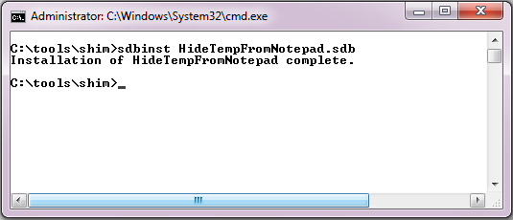
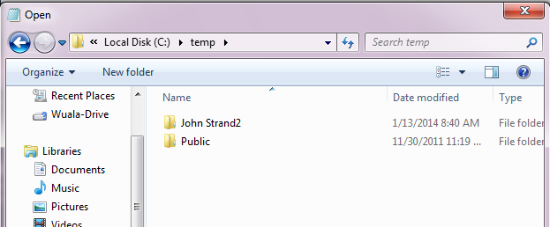
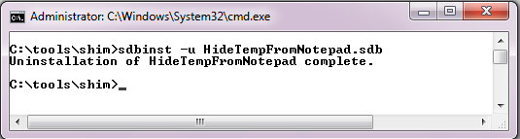
Run the Shim
0
Don’t Forget to
Restart Notepad
After the Shim is
Installed!!!
1
2
3
Don’t Forget to
Uninstall your Shim
4
Notes:
From the command line, run the following command:
C:\tools\shim> sdbinst HideTempFromNotepad.sdb
Now, reopen notepad.exe and navigate to the C:\temp directory.
Instead of seeing an empty folder, you should see the contents of your Users directory. We have successfully “tricked” notepad into looking in the wrong place. This technique is very useful for attackers to hide files like malicious .exe files or staged .zip files from incident handlers.
Finally, to uninstall the shim, we need to run the following command:
C:\tools\shim> sdbinst –u HideTempFromNotepad.sdb

Slide 6
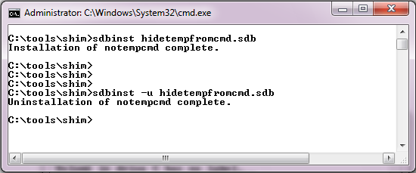
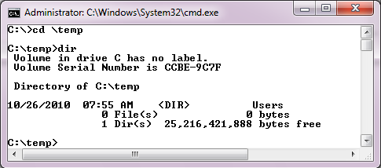
Let’s Shim cmd.exe
0
4
1
2
3
Notes:
Now, let’s do the same thing, but to cmd.exe. As you know, working with command prompts is second nature to expert incident handlers. It is our eyes and our ears to the system. If an attacker messes with cmd.exe, they have significant control over what the handler finds on the computer. In this example, we will be shimming cmd.exe to see the Users directory instead of C:\temp.
First, we will need to install the shim:
0. C:\tools\shim> sdbinst hidetempfromcmd.sdb
Now, open a second cmd.exe window. ***DO NOT CLOSE THE FIRST ONE***
When the second cmd.exe window is open run the following commands to see what is in the temp directory:
1. C:\> cd \temp
2. C:\> dir
Now you should see Users. Once again, we have redirected a utility to see something other than what is really there. Very effective stuff for an attacker.
Let’s clean up our shim.
3. C:\tools\shim> sdbinst –u hidetempfromcmd.sdb

Slide 7
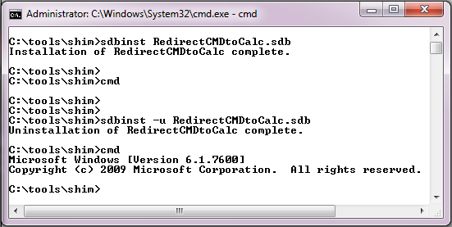
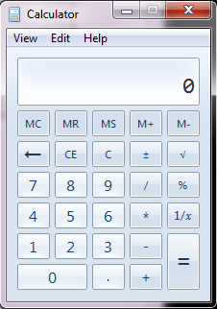
Let’s Redirect cmd.exe
0
1
3
4
2
Notes:
For our last shim we will be playing with execution redirection. This is where you try and open program X and program Y starts instead. Attackers will do this to launch a modified version of applications like cmd.exe which have been modified for their evil purposes. In this example we will be shimming cmd.exe to launch calc.exe instead.
***It is very important that you do not close cmd.exe in this lab until we have removed the shim.***
Please run the following command from your command prompt:
0. C:\tools\shim> sdbinst RedirectCMDtoCalc.sdb
Now, without closing your existing command prompt run the following command:
1. C:\tools\shim> cmd
2. You should see calc.exe start!
Now, let’s uninstall this shim. Run the following command from your existing command prompt:
3. C:\tools\shim> sdbinst –u RedirectCMDtoCalc.sdb
Now, let’s run a quick test to make sure the uninstall worked:
4. C:\tools\shim> cmd.exe
You should see the cmd.exe banner show up in your command prompt window.

Slide 8
Conclusions
We just played with built-in Windows user-mode rootkit “features”
Attackers often take advantage of built-in capabilities to hide their activities from incident handlers
Debugging functionality
Application Compatibility Toolkit
Currently, there is no “fix” for this
It is a feature, which allows Windows to be reverse compatible
You can detect these shims from “Add/Remove Programs”… Unless that is shimmed too!
Feel free to play with the other shims in the C:\tools\shims directory
Also, check out Mark Baggett’s full presentation on the topic
http://www.youtube.com/watch?v=SVqiDdVS7Wo
Notes:
A key component to understanding how rootkits work is understanding what capabilities an operating system has, For example, with the Application Compatibility Toolkit, we are taking advantage of Windows’s built in capability to work with older applications to hide from programs incident handlers would regularly use. This is similar to other rootkits which would use things like built-in debug functionality of an operating system to hide their activities.
A common question about shim rootkits is, “how do we fix this?” Currently, there is no fix, because it is not a “problem” it is a “feature.” Running legacy applications is a very big selling point for Microsoft Windows.
Currently, you can detect these shims by simply looking in Add/Remove programs. Unless that is shimed too!
There are a few other shims we did not have time to play with. If you are feeling adventurous, try them out.
Also, please take a few moments to see Mark Baggett’s full presentation on the topic by visiting the YouTube video referenced in the slide.

